Slide 1
Content Objective: Students will determine which future scenario is most likely for humanity by constructing an argument.
Monday January 27th
Recap Last Class - Why do we like/dislike Tengai?
The Basics of A.I.
Analyzing Data / Perception
Homework
During projects only...

Slide 2
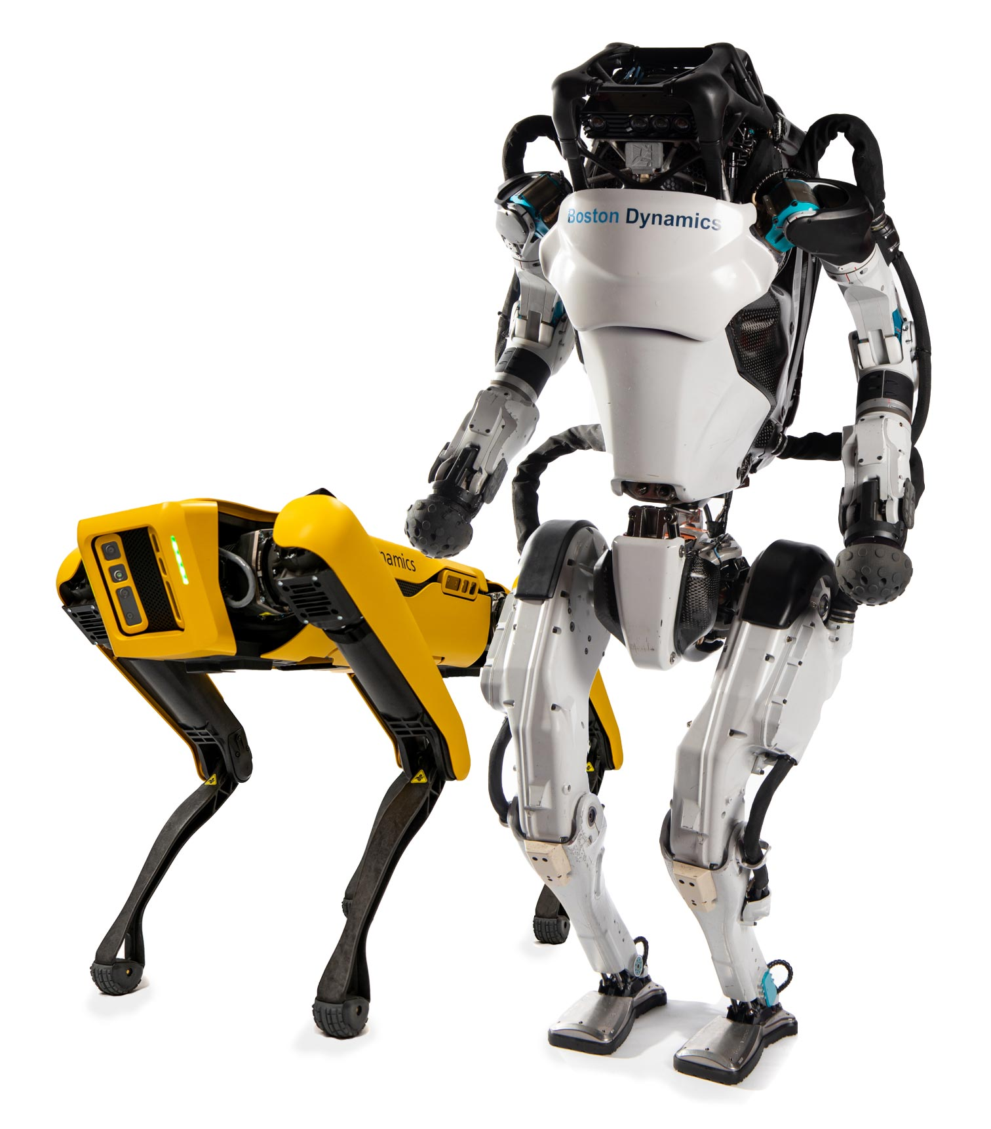
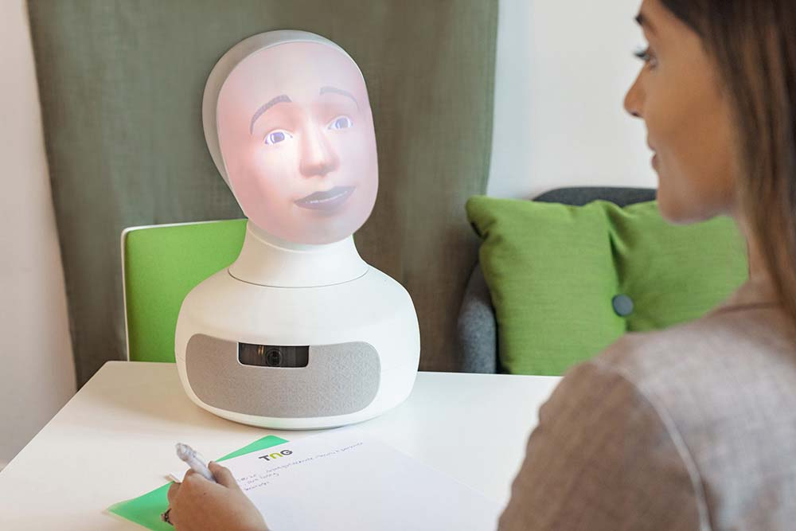
Which Robot would you trust?
A. B. C.
Will always choose the option that leads to the greatest good for the greatest number. Ex. Hires you because you are willing to be a slave for the company.
Will punish those who do wrong and reward those who do right. Believes there is a right and wrong. Ex. Hires you because you are NOT religious.
?
What made choice C. different from choices A and B? Recall Tengai...

Slide 3
How Does a
Computer See?
Please draw a kleenex box...

Slide 4
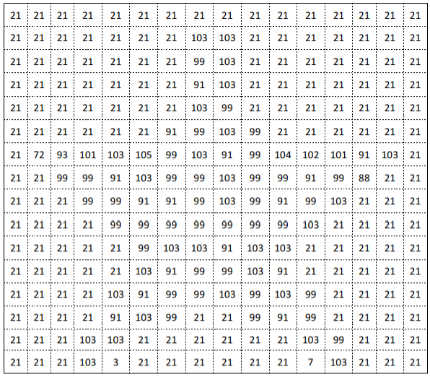
What a computer would see...

Slide 5
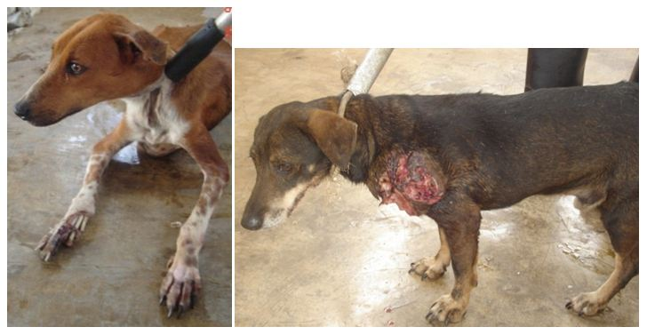
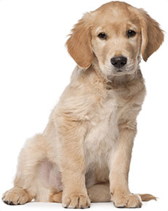
Data & Pattern Recognition - “Computer Thinks”
Eleanor Haberl’s “Imperfect Match”
The Story of Tater Tot
Which of these dogs would you want to take home with you? Why?
vs.

Slide 6

Pattern Recognition
Questions 3 and 4 on the discussion guide portion of the story ask about your pet preference, ethnicity, and family size.
Let’s collect the data of our classroom and see if we can determine any patterns. Do these patterns have significance or not?
The last question asks about how we can improve the AI system in this story. What are some of your thoughts?

Slide 7
Scenario 1 - The Day the Yogurt Took Over
Scenario 2 - The Second Renaissance (9 min in)
Scenario 3 - Sophia Talks About Her Plan
Let’s look at three different societal scenarios...categorize these as being either “evil,” “neutral,” or “good.” Come up with reasons why you feel these outcomes are good or bad and be ready to defend your thinking. Jot down significant moments that seem to go against (or with) your own ethical code.

Slide 8
Which Scenario do you believe is the most likely?
Get in a group of 2-3 and construct an argument for which one of these scenarios you believe is the most likely to play out in the future. Compare / contrast your ethical codes to help guide you. Write 2-3 paragraphs to defend your reasoning.

Slide 9
How does a computer “see”?
Edge Detection Cat Slides

Slide 10
WS Needed for All
Elenor Haberl’s Story - Imperfect Match
A.I. Vision - Slides, Cat WS, Star WS, Kangaroo WS
Intelligent Piece of Paper
Turing Test

Slide 11
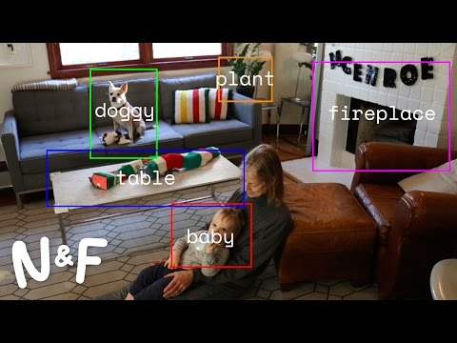
Computer Vision

Slide 12
What is AI actually?

Slide 13
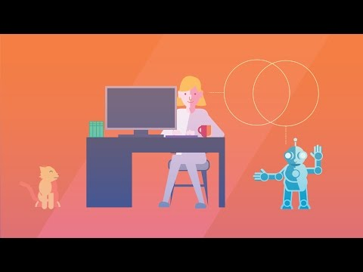
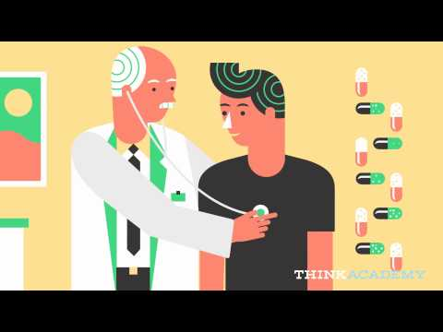
What is AI Wrap Up Video IBM Watson

